Slide 1


2020
Working on Better Solutions.
Oracle資料庫日常維護文件
July 29,2020
Notes:
0

Slide 2
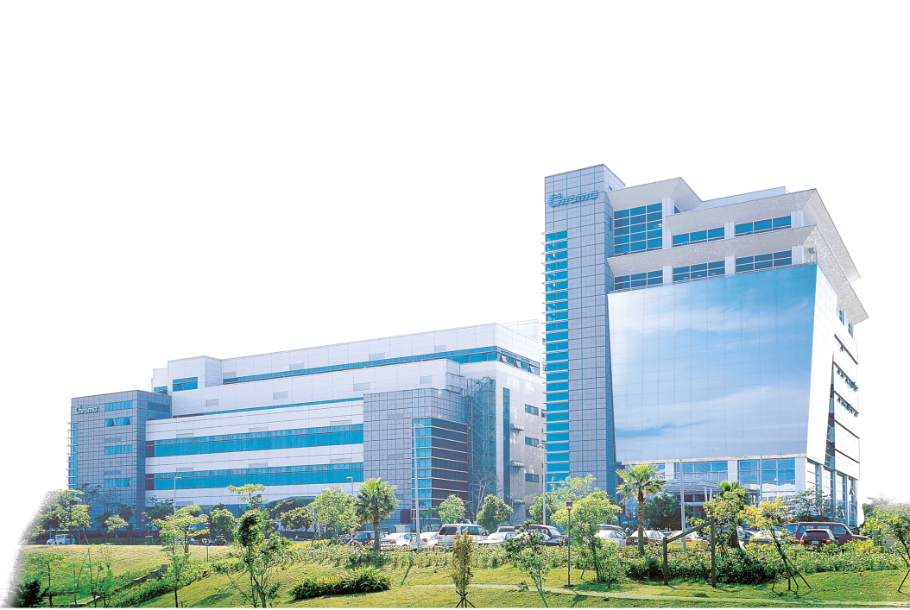
Oracle資料庫日常維護手冊
Oracle 警告日誌檔檢查
資料庫表空間使用情況
Oracle DB問題查詢診斷
DB Lock問題查詢診斷及解除
增加新的Datafile For Tablespace
執行計畫解析
AWR&ADDM&awrsqrpt Report使用
Linux 日常維運
MESDB日常點檢項目
Oracle RAC 日常運維
MESDB Partiton Table

Slide 3

Oracle警告日誌檔檢查

Slide 4
Oracle警告日誌檔檢查
Oracle警告日誌檔檢查→找Alert_sid.Log內 ORA- Error
SQL> set linesize 160
SQL> col value format a70
SQL> show parameter background_dump_dest
NAME TYPE VALUE
------------------------------------ ---------------------- ------------------------------
background_dump_dest string /u01/app/oracle/diag/rdbms/DB名/Instance名/trace
找出Alert.log所在路徑 → /u01/app/oracle/diag/rdbms/mesdb/mesdb1/trace
檔名: alert_SID.log SID=DB_SID名字
SQL> select instance_name,status from v$instance;
INSTANCE_NAME STATUS
---------------- ------------
mesdb1 OPEN
SQL> select name from v$database;
NAME
--------------------
MESDB

Slide 5
資料庫表空間使用情況

Slide 6
資料庫表空間使用情況
select
a.tablespace_name,
SUM(a.bytes)/1024/1024 "CurMB",
SUM(decode(b.maxextend,
null,
A.BYTES/1024/1024,
b.maxextend*8192/1024/1024)) "MaxMB",
(SUM(a.bytes)/1024/1024 - (c."Free"/1024/1024)) "TotalUsed",
(SUM(decode(b.maxextend,
null,
A.BYTES/1024/1024,
b.maxextend*8192/1024/1024)) - (SUM(a.bytes)/1024/1024 - round(c."Free"/1024/1024))) "TotalFree",
round(100*(SUM(a.bytes)/1024/1024 - round(c."Free"/1024/1024))/(SUM(decode(b.maxextend,
null,
A.BYTES/1024/1024,
b.maxextend*8192/1024/1024)))) "UPercent" from dba_data_files a,
sys.filext$ b,
(SELECT d.tablespace_name , sum(nvl(c.bytes,0)) "Free"
FROM dba_tablespaces d,DBA_FREE_SPACE c
where d.tablespace_name = c.tablespace_name(+) group by d.tablespace_name) c
where a.file_id = b.file#(+) and a.tablespace_name = c.tablespace_name
GROUP by a.tablespace_name, c."Free"/1024
order by round(100*(SUM(a.bytes)/1024/1024 - round(c."Free"/1024/1024))/(SUM(decode(b.maxextend, null, A.BYTES/1024/1024, b.maxextend*8192/1024/1024)))) desc;
資料庫表空間使用情況檢查
SET LINES 700
SET PAGESIZE 100
SET FEEDBACK OFF
SET TRIMSPOOL ON
SET ECHO OFF
COL TABLESPACE_NAME FOR A30

Slide 7
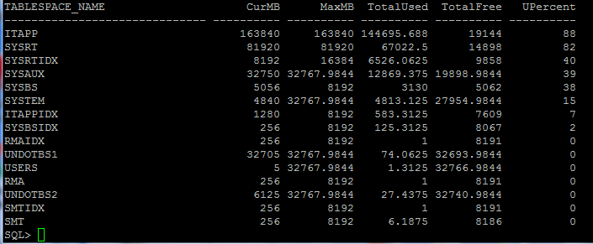
資料庫表空間使用情況
資料庫表空間使用情況檢查

Slide 8
Oracle Tablespace Architecture
Segment
112K
(Table, Index, etc.)
TABLESPACE
Extent
28K
Extent
84K
Database Blocks
datafile 2
datafile 1
datafile 3
datafile 4
datafile 5

Slide 9
增加新的Datafile For Tablespace
SQL> set linesize 160
col file_name format a65
select file_id,file_name,tablespace_name from dba_data_files;
FILE_ID FILE_NAME TABLESPACE_NAME
---------- ----------------------------------------------------------------- ------------------------------
4 +DATA/tfwmesdb/datafile/users.259.847038461 USERS
3 +DATA/tfwmesdb/datafile/undotbs1.258.847038461 UNDOTBS1
2 +DATA/tfwmesdb/datafile/sysaux.257.847038461 SYSAUX
1 +DATA/tfwmesdb/datafile/system.256.847038459 SYSTEM
5 +DATA/tfwmesdb/datafile/undotbs2.264.847038647 UNDOTBS2
6 +DATA/tfwmesdb/datafile/itapp.278.847121021 ITAPP
7 +DATA/tfwmesdb/datafile/itappidx.279.847121189 ITAPPIDX
8 +DATA/tfwmesdb/datafile/rma.280.847121311 RMA
9 +DATA/tfwmesdb/datafile/rmaidx.281.847121341 RMAIDX
10 +DATA/tfwmesdb/datafile/smt.282.847121409 SMT
11 +DATA/tfwmesdb/datafile/smtidx.283.847121447 SMTIDX
12 +DATA/tfwmesdb/datafile/sysbs.284.847121567 SYSBS
13 +DATA/tfwmesdb/datafile/sysbsidx.285.847121609 SYSBSIDX
14 +DATA/tfwmesdb/datafile/sysrt.286.847121765 SYSRT
15 +DATA/tfwmesdb/datafile/sysrtidx.287.847121807 SYSRTIDX
16 +DATA/tfwmesdb/datafile/sysrt.288.847380481 SYSRT
17 +DATA/tfwmesdb/datafile/sysrtidx.289.847381733 SYSRTIDX
18 +DATA/tfwmesdb/datafile/sysrt.290.847385271 SYSRT
19 +DATA/tfwmesdb/datafile/itapp.291.870032365 ITAPP
add New Datafile for SYSBS Tablespace
alter tablespace SYSBS add datafile '+DATA/tfwmesdb/datafile/itapp01.dbf' size 8192M;
alter database datafile '+DATA/tfwmesdb/datafile/itapp01.dbf' autoextend on maxsize unlimited;

Slide 10
查詢Table存放在哪個Datafile
SQL> set linesize 150
SQL> col table_name format a30;
SQL> col file_name format a40;
SQL> col tablespace_name format a20;
SQL> select b.FILE_ID,b.FILE_NAME,a.TABLESPACE_NAME,a.TABLE_NAME,a.owner
From dba_tables a,dba_data_files b
where a.TABLESPACE_NAME=b.TABLESPACE_NAME
AND A.TABLE_NAME='EMS_VENDOR';

Slide 11
Oracle DB問題查詢診斷

Slide 12
Oracle DB問題查詢診斷
查詢DB_Lock語法和抓取SQL_ID及Relase DB_Lock
抓SQL_ID
SELECT se.sid,se.serial#,pr.SPID,se.username,se.status,se.terminal,se.program,se.MODULE,se.SQL_ID,se.sql_address,st.event,st.p1text,si.physical_reads,si.block_changes
FROM v$session se,v$session_wait st,v$sess_io si,v$process pr
WHERE st.sid=se.sid AND st.sid=si.sid AND se.PADDR=pr.ADDR ORDER BY SID DESC;
select sql_text from v$sql where address = '6875BABC';
alter system kill session 'sid, serial#';
找出對應系統的Process ID=spid
select spid from v$process where addr=(select paddr from v$session where sid=(select distinct sid from v$mystat));
Oracle 根據sid找出spid
select pro.spid from v$session ses,v$process pro where ses.sid=xxx and ses.paddr=pro.addr;
根據SPID找出SID,SERIAL
select s.sid,s.serial# from v$session s,v$process p where s.paddr=p.addr and p.spid='xxx'

Slide 13
Oracle DB問題查詢診斷
等待事件說明
等待事件 event v$session_wait | 意義/說明
Buffer busy wait | 等待事件常見於資料庫中存在的熱塊的時候，當多個用戶頻繁地讀取或者修改同樣的數據塊時，這個等待事件就會產生。
db file scattered read | 與全表掃描(Full Table Scan)相關的等待。
db file sequential read | 當Oracle 需要每次I/O只讀取單個數據塊這樣的操作時，會產生這個等待事件。 最常見的情況有索引的訪問。
Log Buffer Space | 通常是表示 Redo Log Buffer過小。
Log File Switch | Commit的請求都需要等待Redo Log File切換的完成。是因為日誌組循環寫滿以後第一個日誌檔尚未完成，出現該等待。
Log File Sync | Commit或RollBack資料庫時， LGWR將SESSION的重做由日誌緩衝寫入到重做日誌中。日誌檔案同步過程必須等待這一過程成功完成。
Control File Parallel write | Process更新所有控制檔案時，這個事件可能出現。
Log file single write | 這個等待事件發生在更新Rdo log文件的文件Header時，當為日誌組增加新的日誌成員時或者Redo log的Sequence號改變時，LGWR 都會更新Redo log文件Header信息。
Oracle 其餘等待事件請參考附件。

Slide 14
DB Lock問題查詢診斷及解除

Slide 15
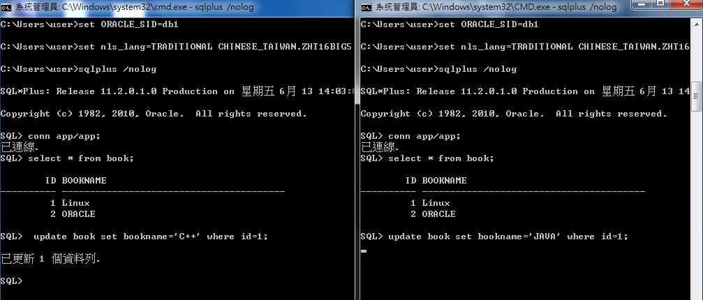
DB Lock問題查詢診斷及解除
DB_Lock鎖定情況:Session1 & Session2 (Session都尚未Commit)

Slide 16
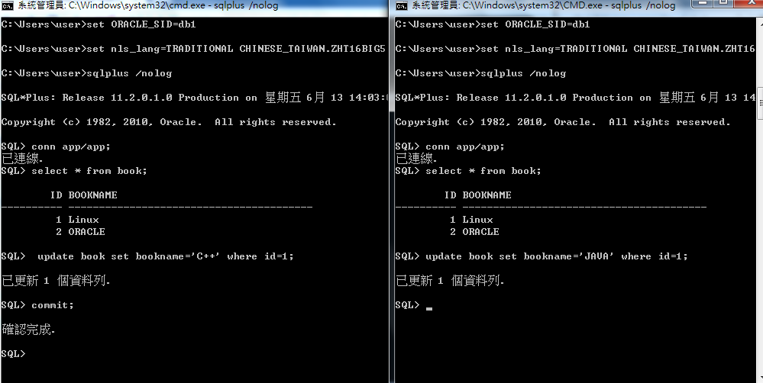
DB Lock問題查詢診斷及解除
DB_Lock鎖定情況:Session1 & Session2 (Session1→Commit)

Slide 17
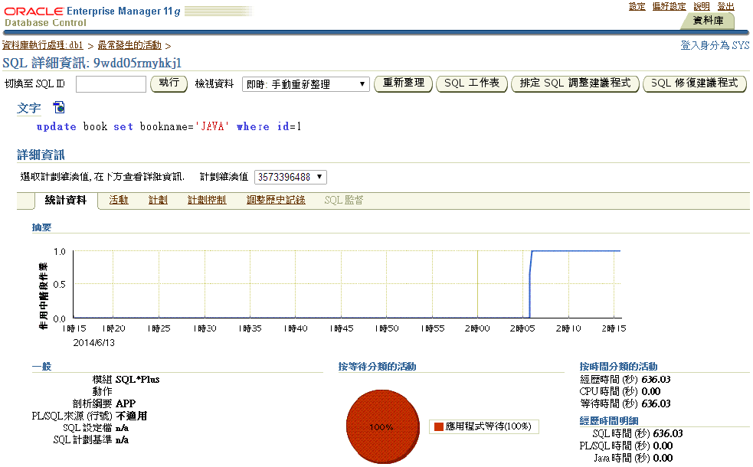
DB Lock問題查詢診斷及解除

Slide 18
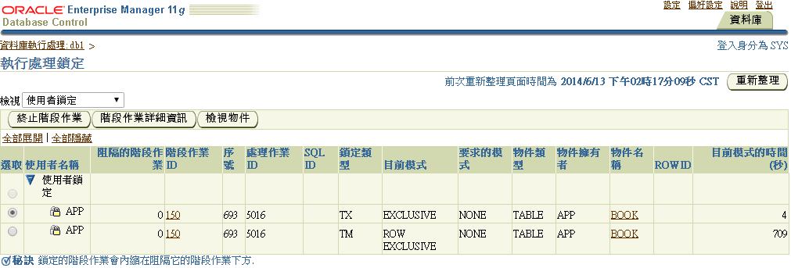
DB Lock問題查詢診斷及解除
DB_Lock鎖定情況:Session1 Commit後Session2情況)

Slide 19

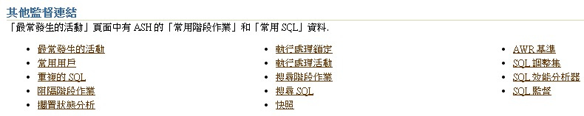
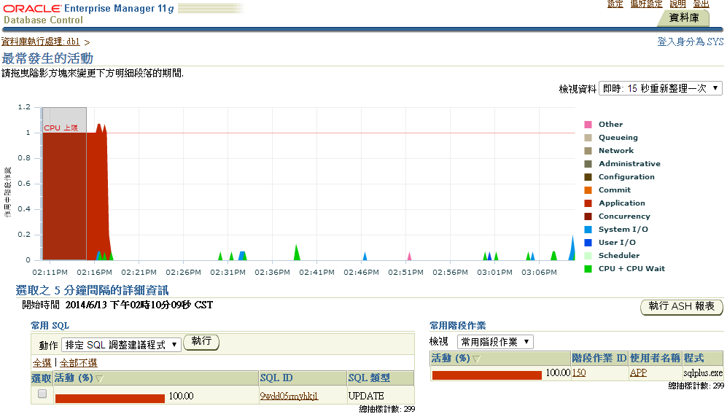
DB Lock問題查詢診斷及解除
在Home頁面上點選→效能→其他監督連結→最常發生的活動→回朔DB Lock情況

Slide 20
DB Lock問題查詢診斷及解除
查詢DB_Lock語法和抓取SQL_ID及Relase DB_Lock
SELECT SID, DECODE(BLOCK, 0, 'NO', 'YES' ) BLOCKER,
DECODE(REQUEST, 0, 'NO','YES' ) WAITER
FROM V$LOCK
WHERE REQUEST > 0 OR BLOCK > 0
ORDER BY block DESC;
select a.session_id as SID,
b.serial#,
a.owner,
a.name,
a.MODE_HELD
from dba_dml_locks a,v$session b
where a.session_id = b.sid and b.status = 'INACTIVE';
抓SQL_ID
SELECT se.sid,se.serial#,pr.SPID,se.username,se.status,se.terminal,se.program,se.MODULE,se.SQL_ID,se.sql_address,st.event,st.p1text,si.physical_reads,si.block_changes
FROM v$session se,v$session_wait st,v$sess_io si,v$process pr
WHERE st.sid=se.sid AND st.sid=si.sid AND se.PADDR=pr.ADDR ORDER BY SID DESC;
select sql_text from v$sql where address = '6875BABC';
alter system kill session 'sid, serial#';

Slide 21
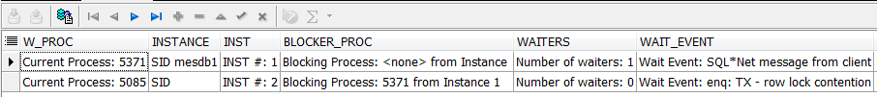
DB Lock問題查詢診斷及解除
RAC DB查詢DB Lock方式
SELECT *
FROM (SELECT 'Current Process: '||osid W_PROC, 'SID '||i.instance_name INSTANCE,
'INST #: '||instance INST,'Blocking Process: '||decode(blocker_osid,null,'<none>',blocker_osid)||
' from Instance '||blocker_instance BLOCKER_PROC,'Number of waiters: '||num_waiters waiters,
'Wait Event: ' ||wait_event_text wait_event, 'P1: '||p1 p1, 'P2: '||p2 p2, 'P3: '||p3 p3,
'Seconds in Wait: '||in_wait_secs Seconds, 'Seconds Since Last Wait: '||time_since_last_wait_secs sincelw,
'Wait Chain: '||chain_id ||': '||chain_signature chain_signature,'Blocking Wait Chain: '||decode(blocker_chain_id,null,
'<none>',blocker_chain_id) blocker_chain
FROM v$wait_chains wc,
v$instance i
WHERE wc.instance = i.instance_number (+)
AND ( num_waiters > 0
OR ( blocker_osid IS NOT NULL
AND in_wait_secs > 10 ) )
ORDER BY chain_id,
num_waiters DESC)
WHERE ROWNUM < 101;

Slide 22
DB Lock問題查詢診斷及解除
RAC DB查詢DB Lock方式
SELECT b.inst_id,LPAD('--->',DECODE(A.request,0,0,5))||A.SID SID, a.id1, a.id2, a.lmode, a.BLOCK, a.request, DECODE(a.TYPE, 'MR', 'Media Recovery', 'RT', 'Redo Thread', 'UN', 'User Name', 'TX', 'Transaction', 'TM', 'DML', 'UL', 'PL/SQL User Lock', 'DX', 'Distributed Xaction', 'CF', 'Control File', 'IS', 'Instance State', 'FS', 'File Set', 'IR', 'Instance Recovery', 'ST', 'Disk Space Transaction', 'TS', 'Temp Segment', 'IV', 'Library Cache Invalidation', 'LS', 'Log Start or Switch', 'RW', 'Row Wait', 'SQ', 'Sequence Number', 'TE', 'Extend Table', 'TT', 'Temp Table', a.TYPE) lock_type, b.PROGRAM,b.OSUSER ,b.USERNAME,b.status, b.module,b.action ,b.LOGON_TIME,b.LAST_CALL_ET, 'alter system kill session ' || '''' || a.SID || ', ' || b.serial# ||'''' || ' immediate;' kill_session, DECODE(object_type, NULL, NULL, 'Dbms_Rowid.rowid_create(1, ' || row_wait_obj# || ', ' || row_wait_file# ||', ' || row_wait_block#||', ' || row_wait_row# ||')') row_id FROM gV$LOCK a, gv$session b, dba_objects o WHERE (a.id1,a.id2) IN (SELECT id1,id2 FROM gV$LOCK WHERE lmode=0) AND a.INST_ID=b.INST_ID AND a.SID=b.SID AND o.object_id (+) = DECODE(b.ROW_WAIT_OBJ#, -1, NULL, b.ROW_WAIT_OBJ#) ORDER BY a.id1,a.id2,a.request;

Slide 23
追蹤應用程式的SQL敘述句

Slide 24
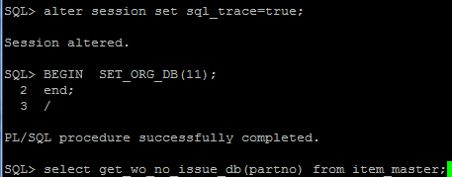
追蹤應用程式的SQL敘述句
SQL> select spid from v$process where addr=(select paddr
from v$session where sid=(select distinct sid from v$mystat));
SPID
------------
24763
SELECT se.sid,se.serial#,pr.SPID,se.username,se.status,se.terminal,se.program,se.MODULE,se.sql_address,st.event,st.p1text,si.physical_reads,si.block_changes
FROM v$session se, v$session_wait st,v$sess_io si,v$process pr
WHERE st.sid=se.sid AND st.sid=si.sid AND se.PADDR=pr.ADDR and spid=24763
SQL> alter session set sql_trace=true;
SQL> alter session set sql_trace=false;

Slide 25
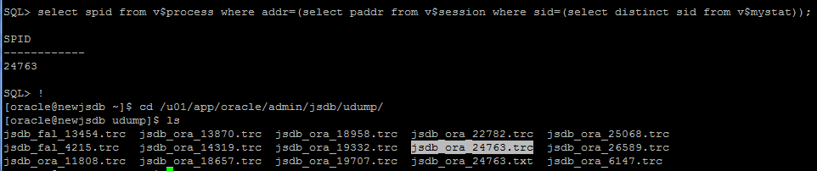
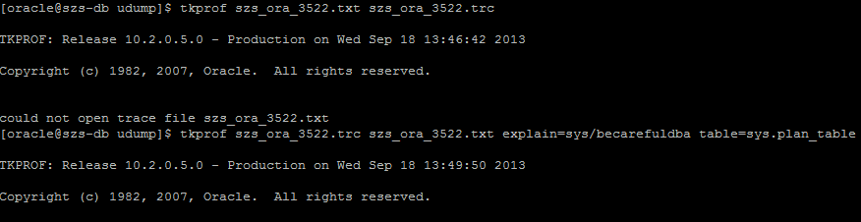
追蹤應用程式的SQL敘述句
SQL> select spid from v$process where addr=(select paddr
from v$session where sid=(select distinct sid from v$mystat));
SPID
------------
24763 找出spid=24763
[oracle@szs-db udump]$ tkprof jsdb_ora_24763.trc jsdb_ora_24763.txt
explain=sys/becarefuldba table=sys.plan_table

Slide 26
執行計畫解析-Explain Plan

Slide 27
執行計畫解析-Explain Plan
SQL> variable B3 varchar2(25);
SQL> exec :B3:='X512-15060035‘
已順利完成 PL/SQL 程序.
SQL>
SQL> variable B1 number;
SQL> exec :B1:= 200060
已順利完成 PL/SQL 程序.
SQL> variable B2 varchar2(40);
SQL> exec :B2:= '15282376‘
已順利完成 PL/SQL 程序.
SQL> SELECT ROWID FROM SAJET.G_SN_TRAVEL WHERE WORK_ORDER = :B3 AND SERIAL_NUMBER = :B2 AND PROCESS_ID = :B1 AND ROWNUM = 1;
ROWID
------------------
AAAFIHAAMAABQaOAAb
使用綁定變數(Bind Variable)方式執行SQL語句。

Slide 28
執行計畫解析-Explain Plan
SQL> select sql_text,sql_id,version_count from v$sqlarea where sql_text like
'SELECT ROWID FROM SAJET.G_SN_TRAVEL WHERE WORK_ORDER = :B3 AND SERIAL_NUMBER = :B2 AND PROCESS_ID = :B1 AND ROWNUM = 1%';
SQL_TEXT
--------------------------------------------------------------------------------
SQL_ID VERSION_COUNT
-------------------------- -------------
SELECT ROWID FROM SAJET.G_SN_TRAVEL WHERE WORK_ORDER = :B3 AND SERIAL_NUMBER = :
B2 AND PROCESS_ID = :B1 AND ROWNUM = 1
a324mp0rxs36f 2
SQL> select * from table(dbms_xplan.display_cursor('a324mp0rxs36f',0,'advanced'));
PLAN_TABLE_OUTPUT
--------------------------------------------------------------------------------
SQL_ID a324mp0rxs36f, child number 0
-------------------------------------
SELECT ROWID FROM SAJET.G_SN_TRAVEL WHERE WORK_ORDER = :B3 AND
SERIAL_NUMBER = :B2 AND PROCESS_ID = :B1 AND ROWNUM = 1

Slide 29
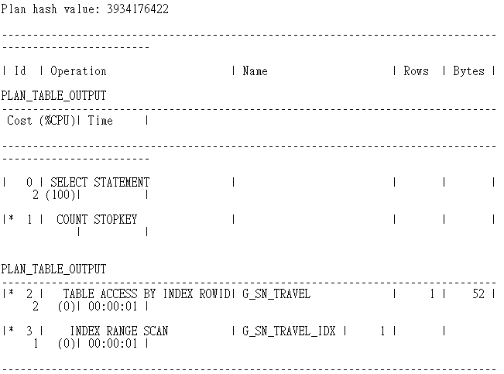
執行計畫解析-Explain Plan

Slide 30
AWR&ADDM&awrsqrpt
Report使用

Slide 31
AWR&ADDM& awrsqrpt
Report使用
C:\Users\mesadmin>sqlplus /nolog
SQL*Plus: Release 11.2.0.1.0 Production on 星期一 7月 14 17:14:15 2014
Copyright (c) 1982, 2010, Oracle. All rights reserved.
SQL> conn sajet/XXXX
已連線.
SQL> @C:\app\Administrator\product\11.2.0\dbhome_1\RDBMS\ADMIN\awrrpt.sql
SQL> @C:\app\Administrator\product\11.2.0\dbhome_1\RDBMS\ADMIN\addmrpt.sql
SQL> @C:\app\Administrator\product\11.2.0\dbhome_1\RDBMS\ADMIN\awrsqrpt.sql

Slide 32
AWR Report使用
Run AWR Report Script
SQL> @C:\app\Administrator\product\11.2.0\dbhome_1\RDBMS\ADMIN\awrrpt.sql
Current Instance
~~~~~~~~~~~~~~~~
DB Id DB Name Inst Num Instance
----------- ------------ -------- ------------
450737658 ADLINKME 1 adlinkmes
Specify the Report Type
~~~~~~~~~~~~~~~~~~~~~~~
Would you like an HTML report, or a plain text report?
Enter 'html' for an HTML report, or 'text' for plain text
Defaults to 'html'
輸入 report_type 的值:html <--輸入html
Type Specified: html
Instances in this Workload Repository schema
~~~~~~~~~~~~~~~~~~~~~~~~~~~~~~~~~~~~~~~~~~~~
DB Id Inst Num DB Name Instance Host
------------ -------- ------------ ------------ ------------
* 450737658 1 ADLINKME adlinkmes ADLINK-MES
Using 450737658 for database Id
Using 1 for instance number

Slide 33
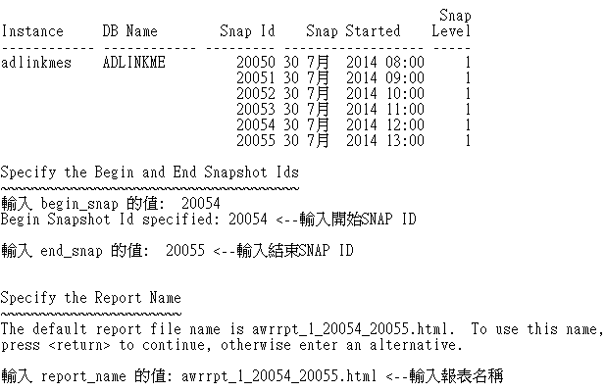
AWR Report使用
Specify the number of days of snapshots to choose from
~~~~~~~~~~~~~~~~~~~~~~~~~~~~~~~~~~~~~~~~~~~~~~~~~~~~~~
Entering the number of days (n) will result in the most recent
(n) days of snapshots being listed. Pressing <return> without
specifying a number lists all completed snapshots.
輸入 num_days 的值: 1 <--輸入近幾天所要的報表
Listing the last 1 days of Completed Snapshots

Slide 34
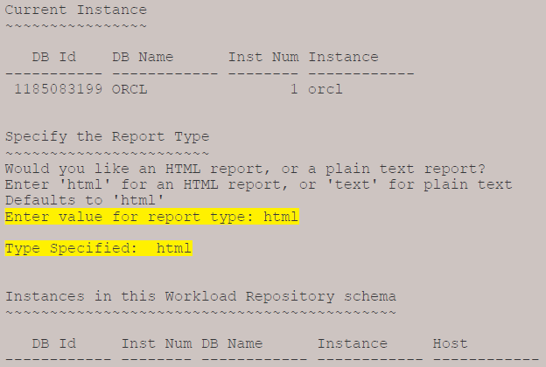
awrsqrpt Report使用
Run awrsqrpt Report Script
SQL> @C:\app\Administrator\product\11.2.0\dbhome_1\RDBMS\ADMIN\awrsqrpt.sql

Slide 35
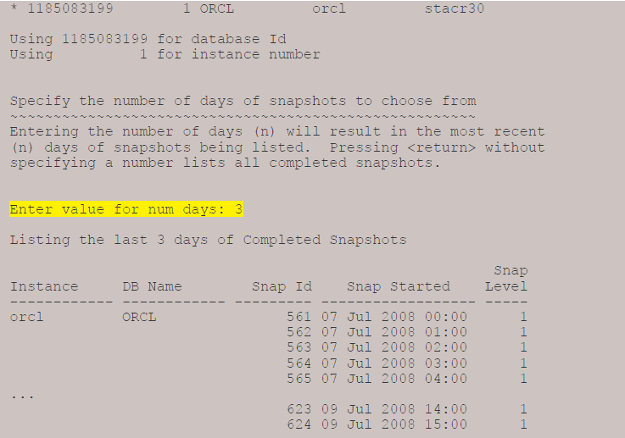
awrsqrpt Report使用
Run awrsqrpt Report Script

Slide 36
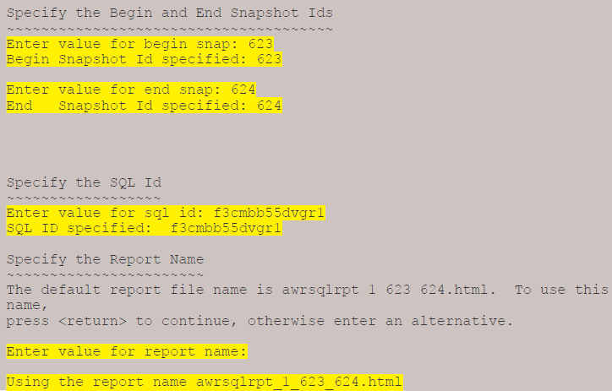
awrsqrpt Report使用
Run awrsqrpt Report Script

Slide 37
Linux 日常維運

Slide 38
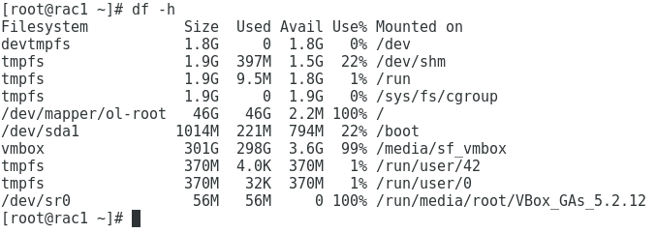
Linux日常維運
檢查硬碟使用量

Slide 39
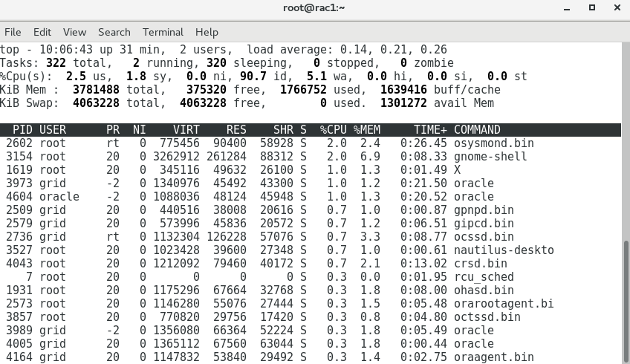
Linux日常維運
檢查Linux OS –cpu,memory 使用量
$ top
$ ctrl + c

Slide 40
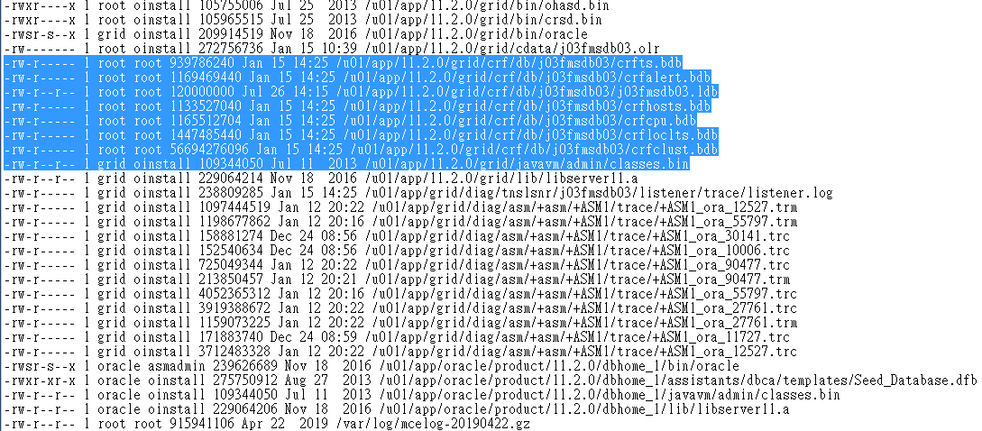
Linux日常維運
檢查/ size > 100m 的檔案和清Log
[root@mesdb1 ~]# find / -type f -size +100M -exec ls -l {} \;
[root@mesdb1 ~]# cd /u01/app/grid/diag/asm/+asm/+ASM1/trace/
[root@mesdb1 ~]# rm *.trc
[root@mesdb1 ~]# mkdir oracle_soft
[root@mesdb1 ~]# rm -rf oracle_soft (清除目錄)

Slide 41
MESDB日常點檢項目

Slide 42
MESDB日常點檢項目
MESDB日常點檢項目
1.檢查Alert.log
2.資料庫表空間使用情況
3. Oracle DB問題查詢診斷-查看Wait Event
4.查看AWR&ADDM報表
5.檢查DataFiles使用數量
6.檢查ASM磁碟連線是否Mount上
7.檢查Oracle Cluster狀態

Slide 43
Oracle RAC 日常運維

Slide 44
RAC日常運維 -檢查ASM硬碟
[root@rac1 ~]# su - grid
[root@rac1 ~]# oracleasm listdisks
DATA
OCR1
OCR2
OCR3
[grid@rac1 ~]$ asmcmd
ASMCMD> ls
DATA/
OCR/

Slide 45

RAC日常運維-檢查ASM使用空間
How to monitor space usage on ASM diskgroups
https://dba.stackexchange.com/questions/36160/how-to-monitor-space-usage-on-asm-diskgroups
root登入後 su - grid
[oracle@oel61 ~]$ sqlplus / as sysdba
SQL*Plus: Release 11.2.0.2.0 Production on Thu Mar 7 10:44:44 2013
Copyright (c) 1982, 2010, Oracle. All rights reserved.
Connected to:
Oracle Database 11g Enterprise Edition Release 11.2.0.2.0 - 64bit Production
With the Automatic Storage Management option
SQL> SELECT name, free_mb, total_mb, free_mb/total_mb*100 as percentage
FROM v$asm_diskgroup;

Slide 46
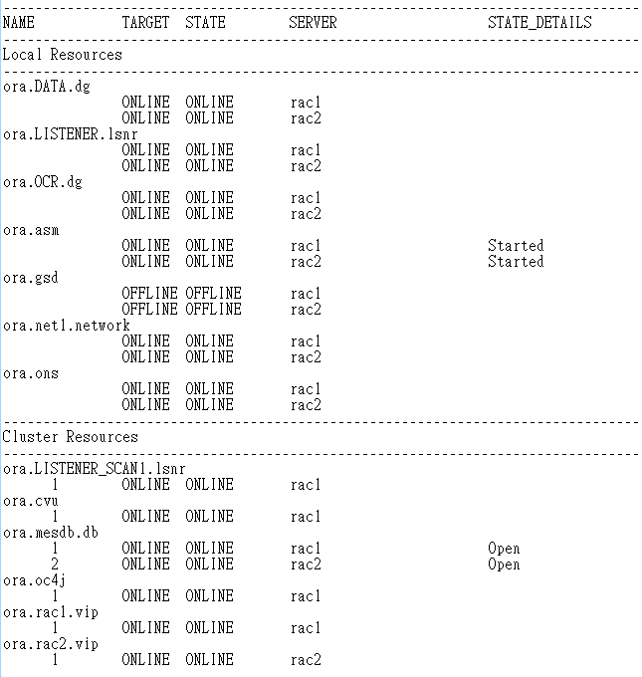
RAC Cluster日常檢查
[root@rac1 ~]# su - grid
[grid@rac1 ~]$ crsctl stat res -t

Slide 47
RAC關機和重開機
1.mesdb1上
[root@mesdb1 ~]#/etc/init.d/ohasd stop
………
等指令結束...
[root@mesdb1 ~]# sync;
[root@mesdb1 ~]# sync;
[root@mesdb1 ~]# sync;
2.mesdb2上
[root@mesdb2 ~]# /etc/init.d/ohasd stop
………
等指令結束...
[root@mesdb2 ~]# sync;
[root@mesdb2 ~]# sync;
[root@mesdb2 ~]# sync;
3.mesdb1和mesdb2上 執行重開機
[root@mesdb1 ~]# reboot 或 shutdown –r now
[root@mesdb2 ~]# reboot 或 shutdown –r now
Linux關機 指令: # init 0 或 #shutdown –h now

Slide 48
RAC維護指令
1).# su - root
2)#cd /u01/app/12.2.0/grid/bin
3)#./crsctl start cluster
或
#./crsctl start cluster -all
4).#su - oracle
5).$srvctl start database -d RAC (啟動全部Instance)
或
6).$srvctl start instance -d RAC -n rac1
7).$srvctl start instance -d RAC -n rac2
8).檢查RAC DB啟動狀態
[grid@mesdb1 ~]$ crsctl stat res -t
[grid@mesdb1 ~]$ crs_stat -t
9). crsctl stop指令的差異
#su - root
#cd /u01/app/12.2.0/grid/bin (分別在所有節點都要做)
#./crsctl stop has - for a Single Instance Wich has ASM on GI
#./crsctl stop crs - for two node rac to stop crs services on each node
#./crsctl stop cluster -all - to stop crs on all nodes

Slide 49
MESDB Partition Table

Slide 50
MESDB Partition Table
SQL> conn sajet/xxxx
SQL> ALTER SESSION SET nls_date_format='YYYY-MM-DD HH24:MI:SS';
SQL> select sysdate from dual;
SQL> set linesize 150
SQL> select partition_name,tablespace_name from user_tab_partitions;
PARTITION_NAME TABLESPACE_NAME
------------------------------------------------------------ --------------------------
G_SN_TRAVEL_2017 TRAVEL2017
G_SN_TRAVEL_2020 TRAVEL2020
G_SN_TRAVEL_2021 TRAVEL2021
G_SN_TRAVEL_2018 TRAVEL2018
G_SN_TRAVEL_2019 TRAVEL2019
加Partition Table
SQL> Alter Table SAJET.G_SN_TRAVEL_2020 add partition G_SN_TRAVEL_2020 VALUES less than (to_date('2020-12-31 23:59:59','yyyy-mm-dd hh24:mi:ss')) Tablespace SN_TRAVEL2020
刪除Partition Table
SQL> alter table G_BIS_DBF_SCHEDULE DROP PARTITION G_SN_TRAVEL_2017;
Table altered.

